Slide 1
Artificial Intelligence
Project
Name’s Generator
SUBMITTED TO:
Mr. Tushar Khitoliya
Mrs. Shagun Sharma
SUBMITTED BY :
Karan Saini (481)

Slide 2
Table of Contents:
Introduction
Overview
Project Snippets
Technical Details
Key Features
Tools and Languages
Conclusion
References/Links used

Slide 3
Introduction
Welcome to the world of Name Generator, where creativity meets artificial intelligence! Our project harnesses the power of AIML (Artificial Intelligence Markup Language) to revolutionize the way names are generated. Whether you're an avid gamer seeking unique character names, an author crafting compelling fictional worlds, or an entrepreneur in need of a standout brand identity, our Name Generator is your ultimate solution.

Slide 4
Overview
Name Generator is an AI tool that generates random names. Which is widely used in our daily websites . It is designed to assist users the unique personalised names for various purpose. Example goes like a fictional character name for movie/series , game character and many more.

Slide 5
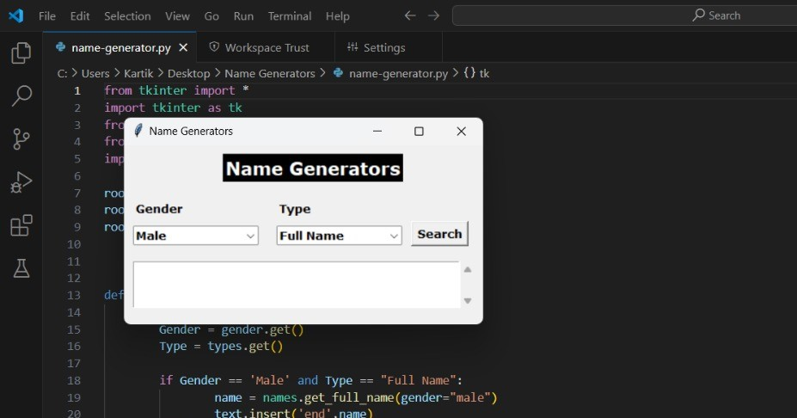
Snippets

Slide 6
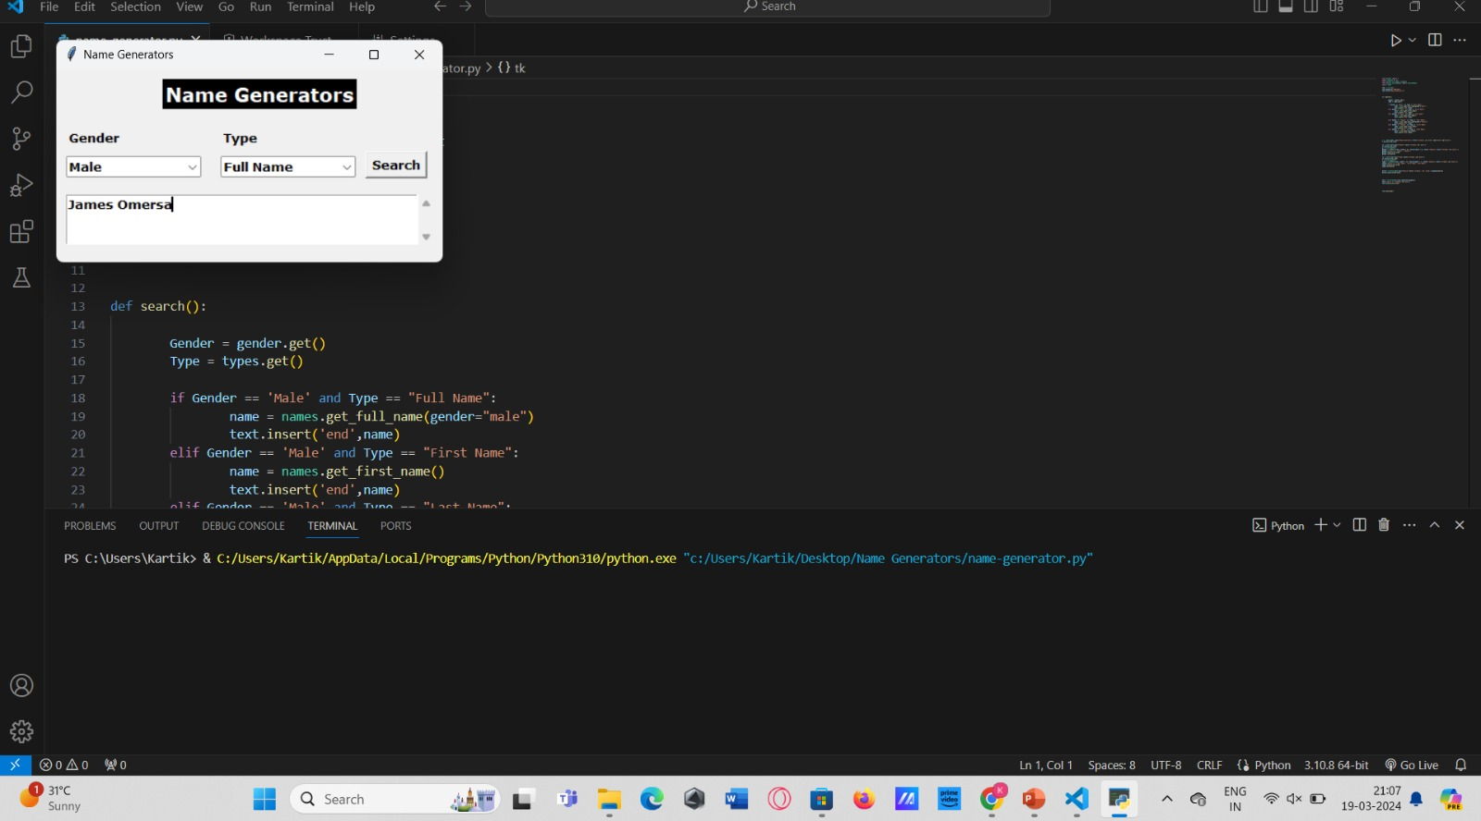
Snippets

Slide 7
Key Features
1. Gender-Based Name Generation:
Gender Recognition: The system recognizes the gender specified by the user or infers it based on contextual cues.
Gender-Specific Suggestions: Generates names that are culturally and linguistically appropriate for the specified gender, ensuring relevance and authenticity.
2. Middle Name Generation:
Customizable Middle Name Patterns: Allows users to define patterns or criteria for generating middle names, such as length, syllable structure, or thematic elements.
Contextual Middle Name Suggestions: Considers the user's preferences and the context of the name (e.g., cultural background, character traits) to provide relevant and meaningful middle name suggestions.
3. Surname Generation:
Surname Variants: Offers variants or alternatives for surnames based on user input, allowing for exploration and creativity in surname selection.

Slide 8
Key Features
4. Interactive User Interface:
Intuitive Interface: Features an intuitive and user-friendly interface that facilitates easy input of gender, middle name, and surname components.
Real-time Suggestions: Provides real-time feedback and suggestions as users input their criteria, enhancing the interactive and dynamic nature of the name generation process.

Slide 9
Technical Details
Programming Languages:
AIML: used to define the conversational logic and pattern matching rules for generating names based on user input
Libraries Used:
1.Tkinter: Tkinter is the standard GUI toolkit included with Python. It provides various widgets (such as buttons, labels, and comboboxes) and methods for building desktop applications with graphical interfaces.

Slide 10
Technical Details
2. ‘from tinkter import * : This line imports all the classes and functions from the Tkinter module into the current namespace. It allows the code to directly reference Tkinter components without specifying the module name.
3. import names

Slide 11
Conclusion-
The project was a Name generator.
Key features of it include :-
A user-friendly interface.
Fresh designs.
Best Suggestor

Slide 12
References/Links used
References of this project have been taken from the below mentioned sites-
https://businessnamegenerator.com/project-name-generator/

Slide 13


